Slide 1


Group 14
Hospital Management
System
DATABASE

Slide 2






Group 14
Meet
THE TEAM
Mohammed Anzal Zafar Shaikh
Sahil Ajay Ruparelia
Yashraj Kadam
Sohni Rais
Sushil Girish
002271996
002853503
002830773
002817666
002815597

Slide 3
PROBLEM STATEMENT
OBJECTIVE
In the rapidly evolving healthcare sector, hospitals face significant challenges in managing vast amounts of data related to patients, staff, departments, and medical services. The absence of a centralized, efficient, and robust data management system leads to operational inefficiencies, data mismanagement, and a decline in patient care quality.
The primary objective of the Hospital Management System Database project is to develop a comprehensive, secure, and user-friendly database system that centralizes and streamlines the storage, retrieval, and management of all hospital-related data. This system aims to:
•Improve data consistency and accessibility, enhancing the overall efficiency of hospital operations.
•Facilitate better coordination between different departments, leading to improved patient care and service delivery.
CURRENT CHALLENGES
EXPECTED OUTCOMES
•Data Fragmentation: Patient and administrative data are scattered across various departments, leading to inconsistent and inaccessible information.
•Operational Inefficiencies: Manual and disjointed data handling processes result in time-consuming and error-prone operations.
•Current Challenges: Lack of real-time data access hinders quick decision-making and timely medical responses.
•Data Security Concerns: Ensuring the confidentiality and integrity of sensitive medical and personal data remains a significant challenge
•A unified platform for managing patient records, departmental data, staff information, and medical services.
•Improved data accuracy and reduced operational errors.
•Enhanced data security and compliance with healthcare regulations.
•Increased staff productivity and patient satisfaction through streamlined processes.

Slide 4
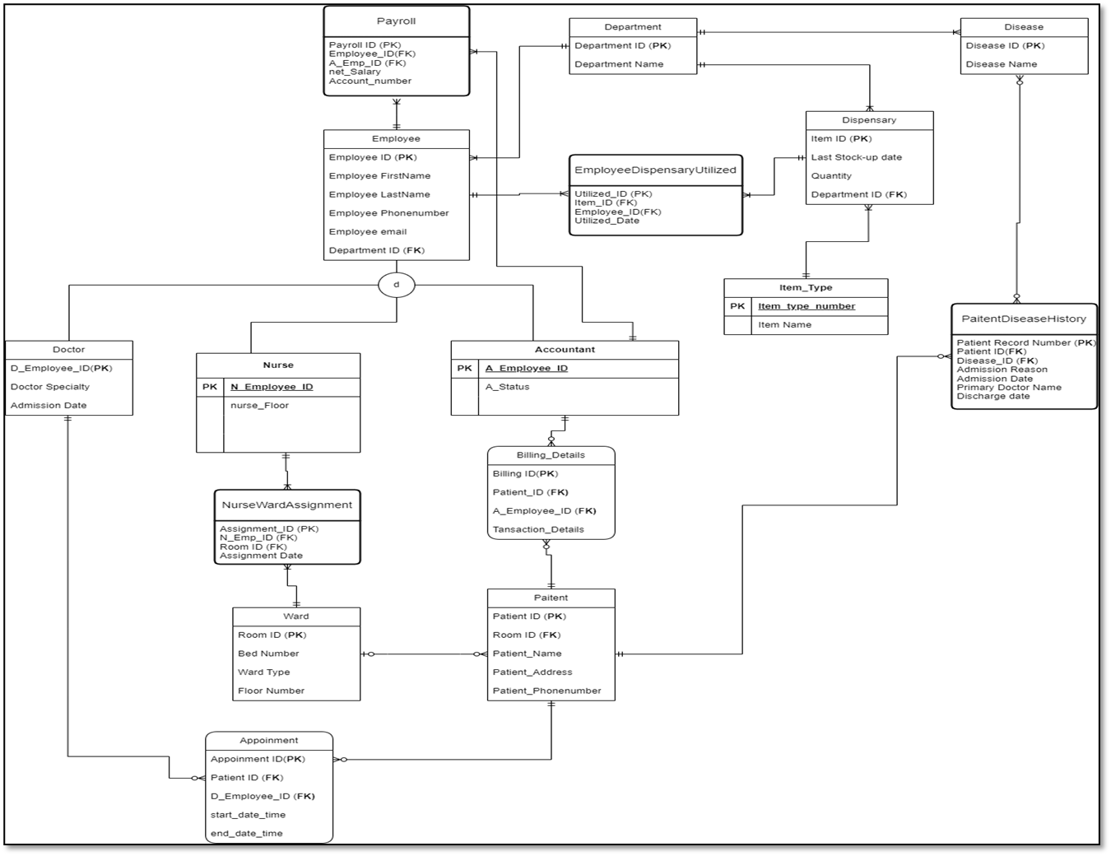
EER
DIAGRAM

Slide 5
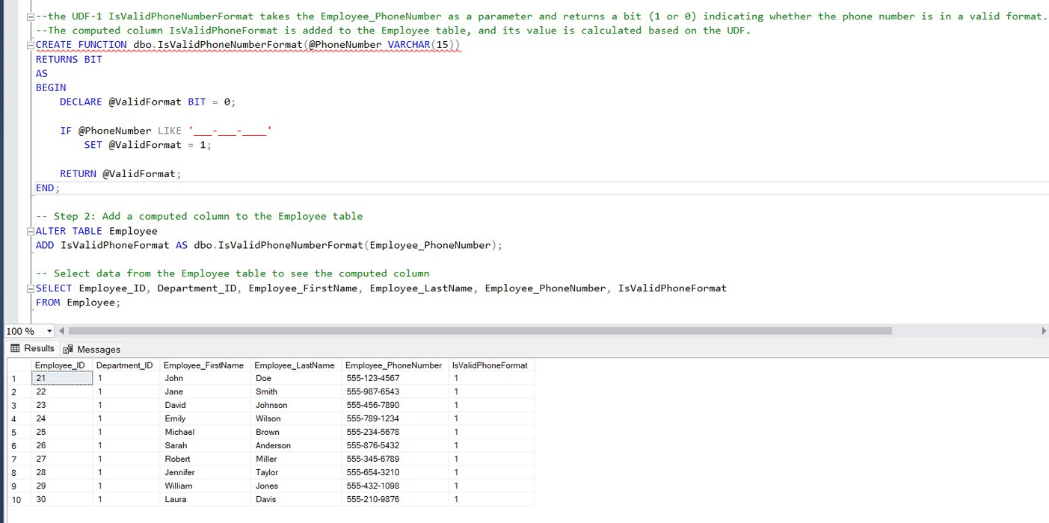
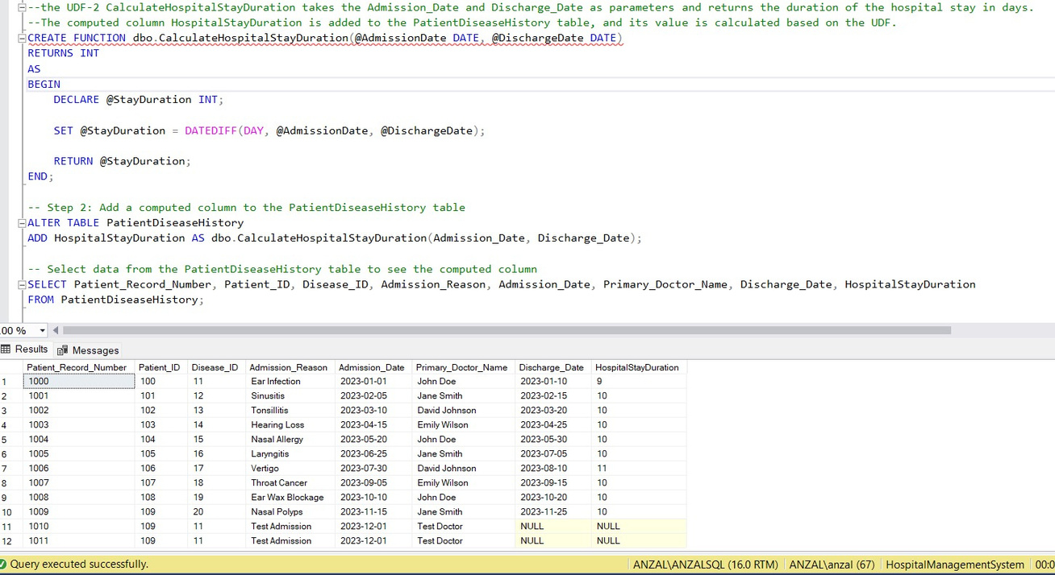
Functions

Slide 6
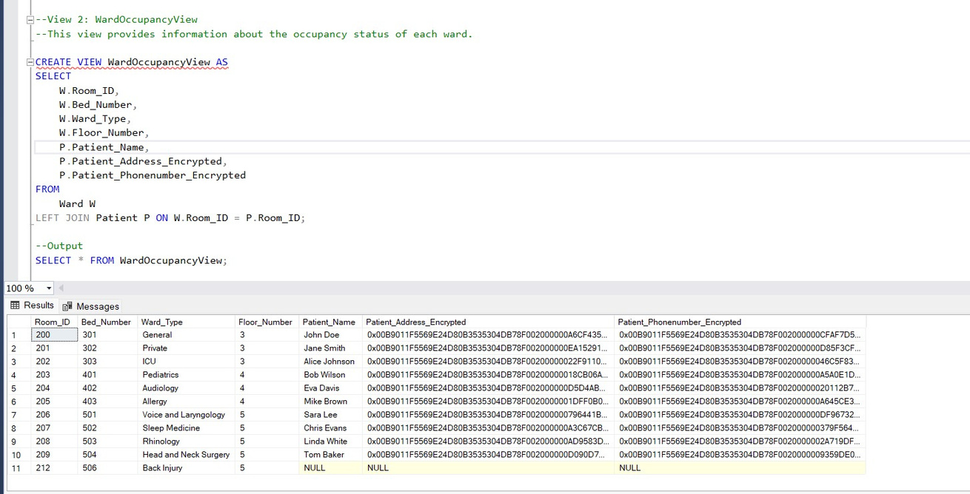
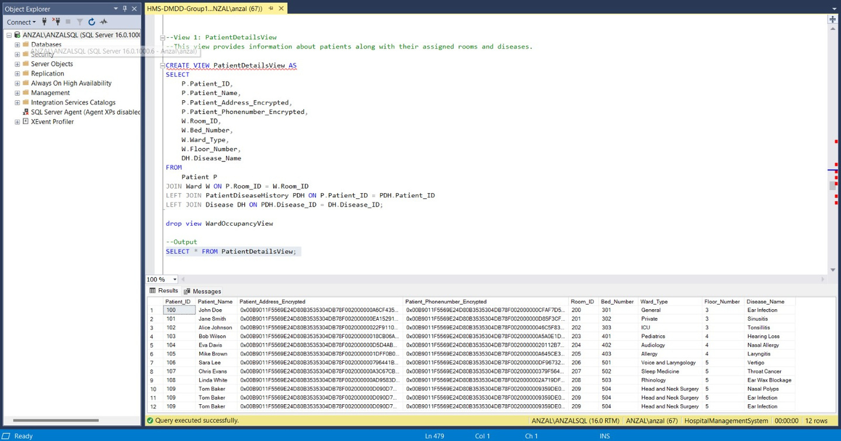
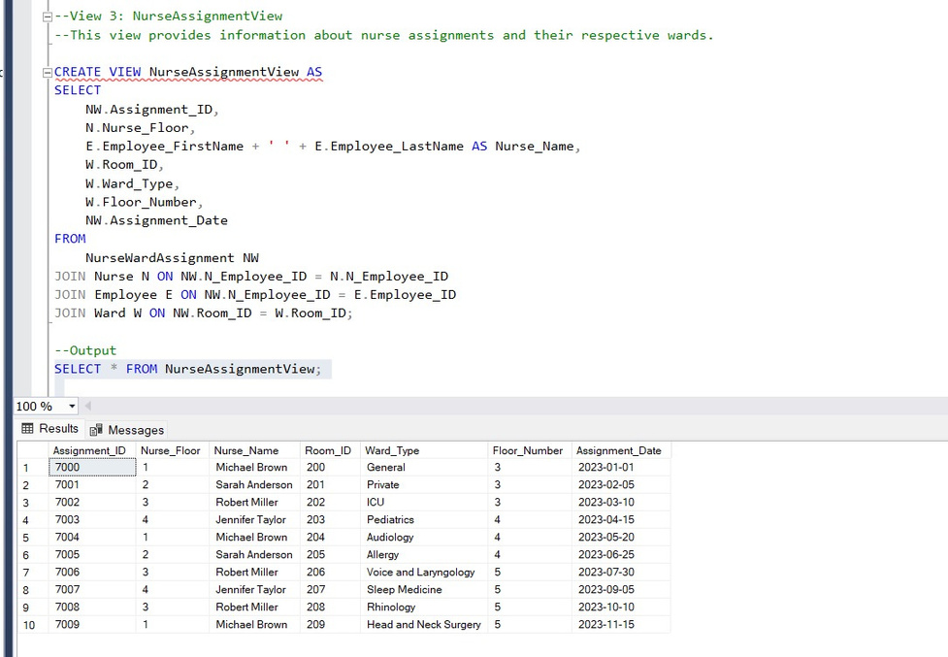
Views

Slide 7
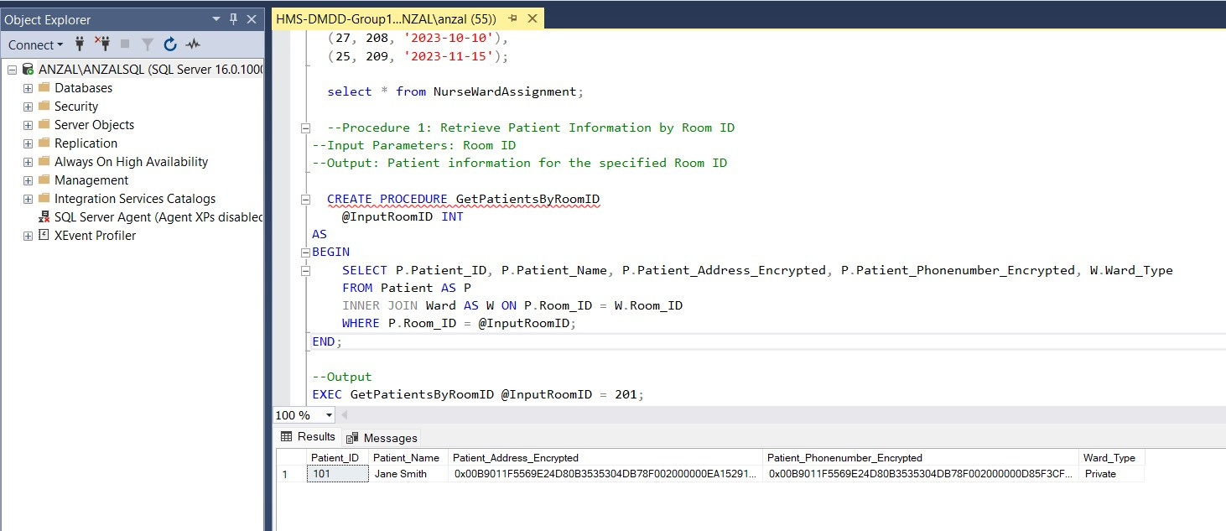
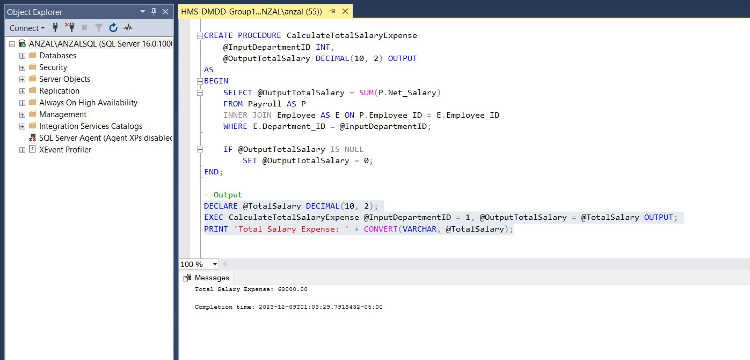
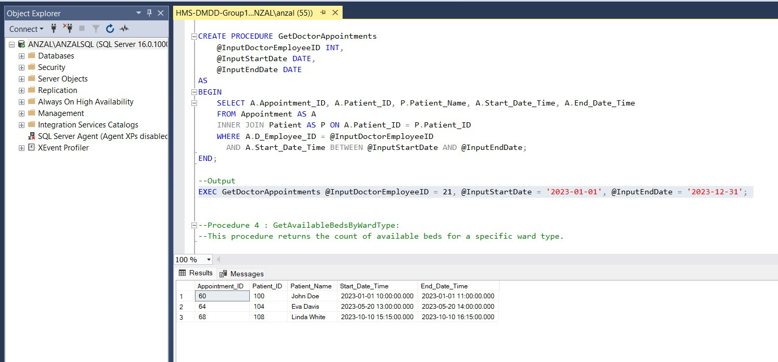
Procedures

Slide 8
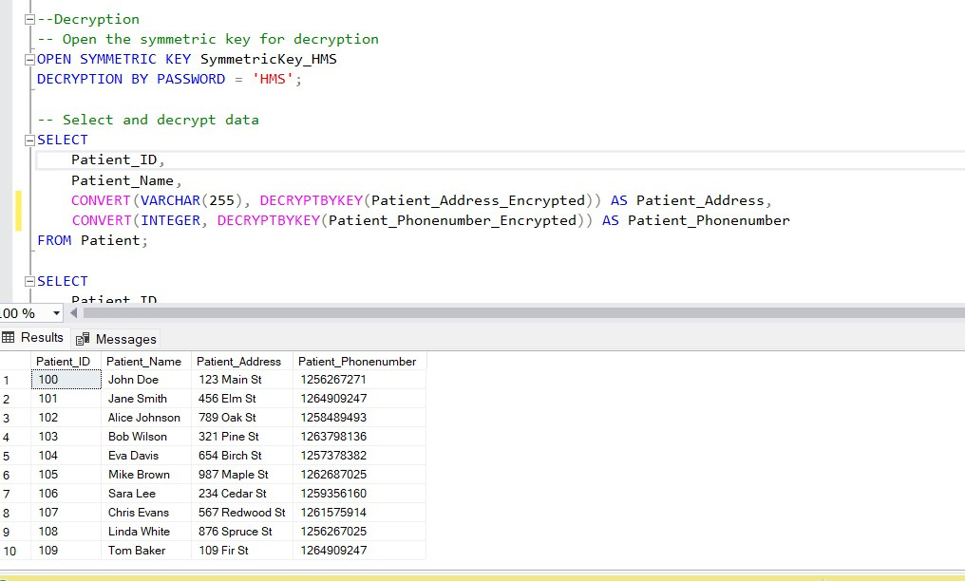
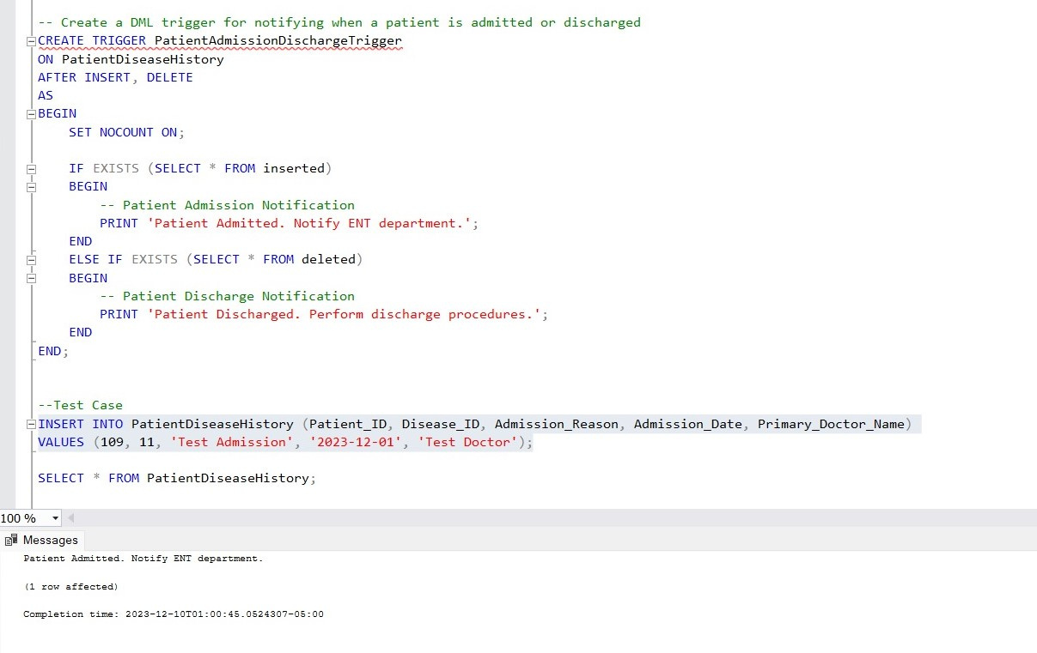
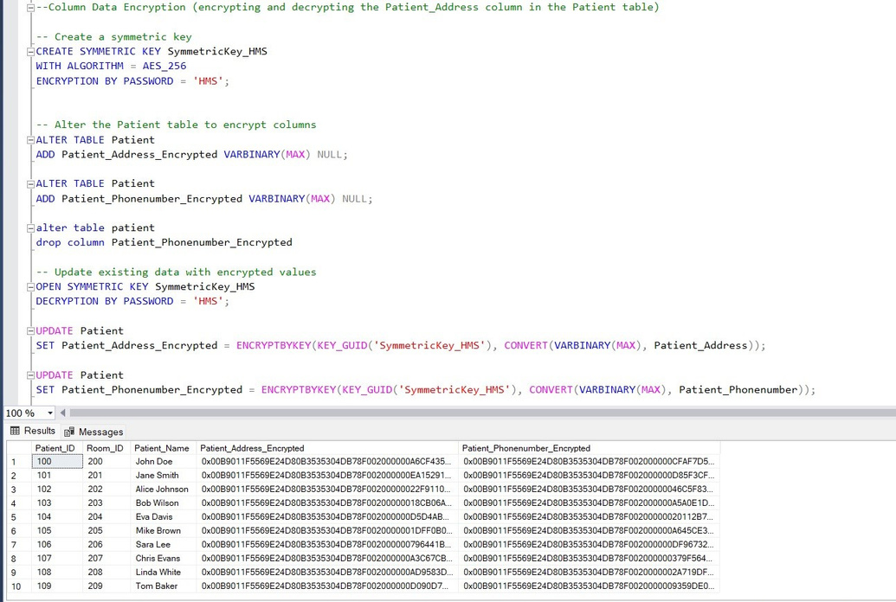
Trigger
Decryption
Column Encryption

Slide 9

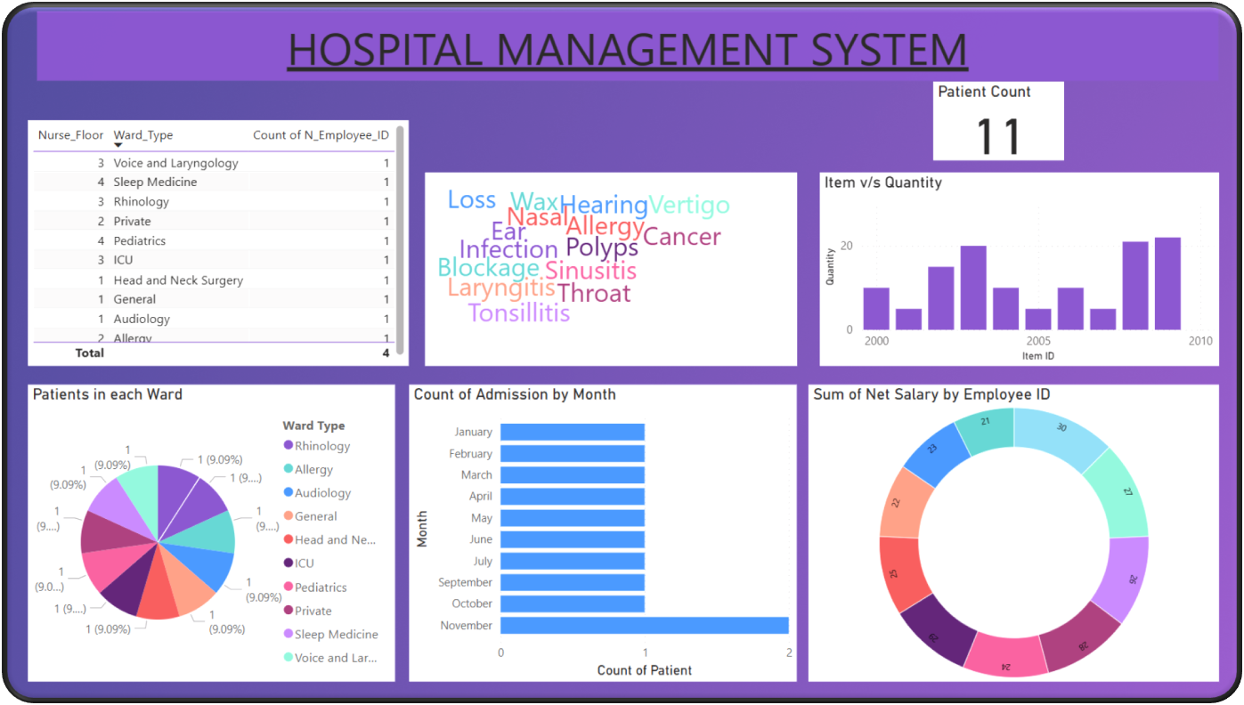
Power BI

Slide 10
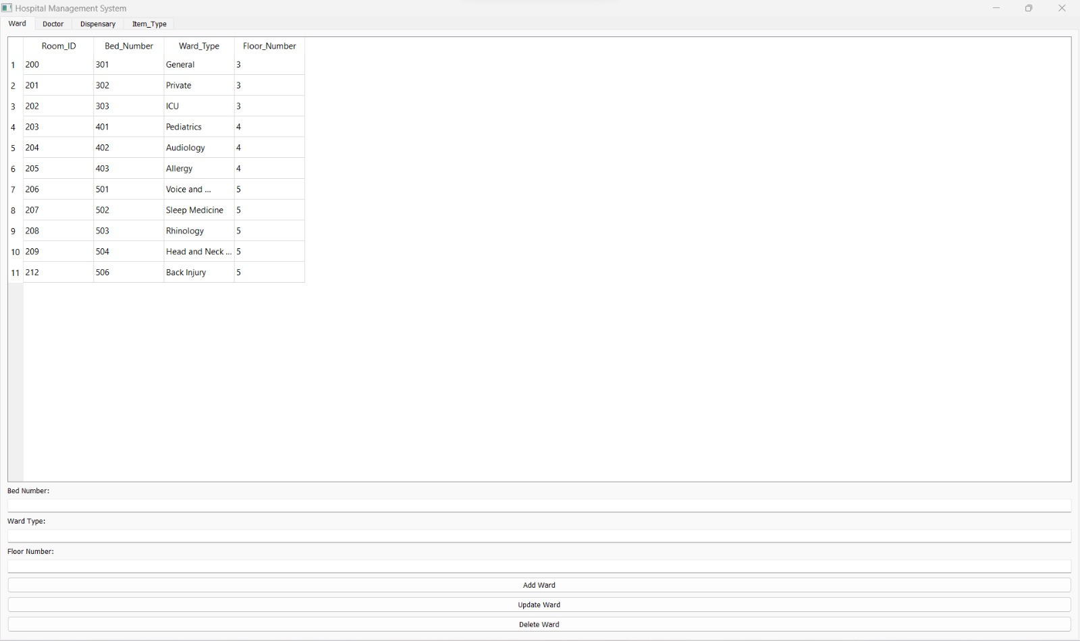
GUI for CRUD Operations using Python

Slide 11
Group 14
THANKYOU!

